Slide 1
Explainable Artificial Intelligence (XAI)
Greater insight into your models
Making more human-understandable analysis

Slide 2
Contents
Introduction and Understanding XAI
A brief overview on XAI
Benefits to stakeholders
Metric for interpretation?
Tabular Data
Interpretable models
Global methods (SHAP + What-If)
CV (Image Data)
Grad-cam
Grad-cam examples
NLP (Sentiment Analysis)
Using Surrogate Models
A look into neural networks
Time Series
Vector Autoregression
LioNETS
Facebook’s Neural Prophet

Slide 3
Understanding XAI
XAI is a subfield where we utilize techniques to simplify the outcome/results of machine learning so that it is easily understandable
The focus of XAI is a shift towards the interpretability part of ML
Pursue of the highest accuracy VS the importance of understanding how and why within reasonable accuracy value
Knowing that there is no perfect scenarios i.e. solutions to global warming

Slide 4
Understanding XAI
The focus of XAI usually falls towards local interpretability
Understanding of the datasets’ attribute and features and their co-relationship between each other for the best suitable outcome
Models can be replicate to suit various scenario thru retraining
Why is it not feasible to apply XAI methodology on a complex model(global)?
Not ideal due to the need to take into consideration significant large inputs

Slide 5
Introduction to XAI
XAI – Helping humans understand the decisions/predictions made by the AI.
A brief overview on XAI:
Incorporating XAI into machine learning models answers the questions of why?
Various scenarios can be fine tune to see the best possible results or worst( to avoid)
Able to adjust the next course-of-action accordingly
Why is it fair?
Decision process are based on logical prediction and it reduces human error compare to real life decision process

Slide 6
Introduction to XAI
XAI – Helping humans understand the decisions/predictions made by the AI.
A brief overview on XAI:
Why is it working/not working as intended?
Knowing how different attributes in the dataset contribute to the outcome
Why is it safe?
Able to simulate various scenarios, and aid users in making positive decisions that are not detrimental

Slide 7
Introduction to XAI
Importance of XAI
What can you gain from understanding the model?
Utility | Stakeholders
Debugging | Engineers
Bias detection | Auditors/Domain expert
Trustability of the prediction | Domain expert
Robustness | Auditors

Slide 8
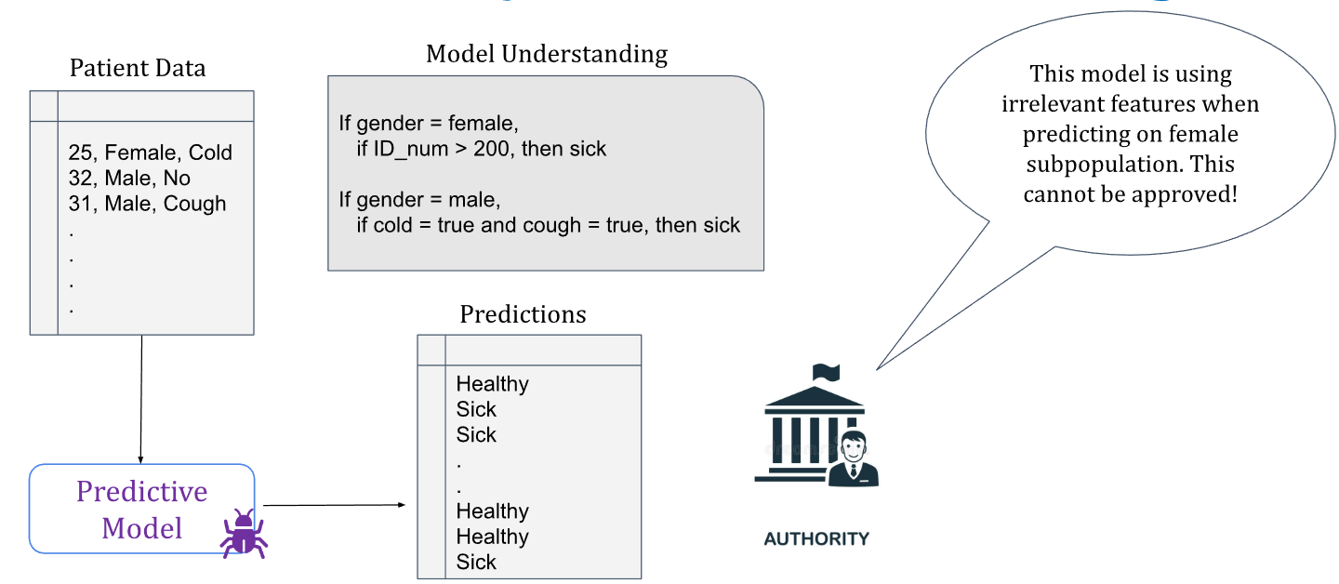
Introduction to XAI
Example 1-Auditors

Slide 9
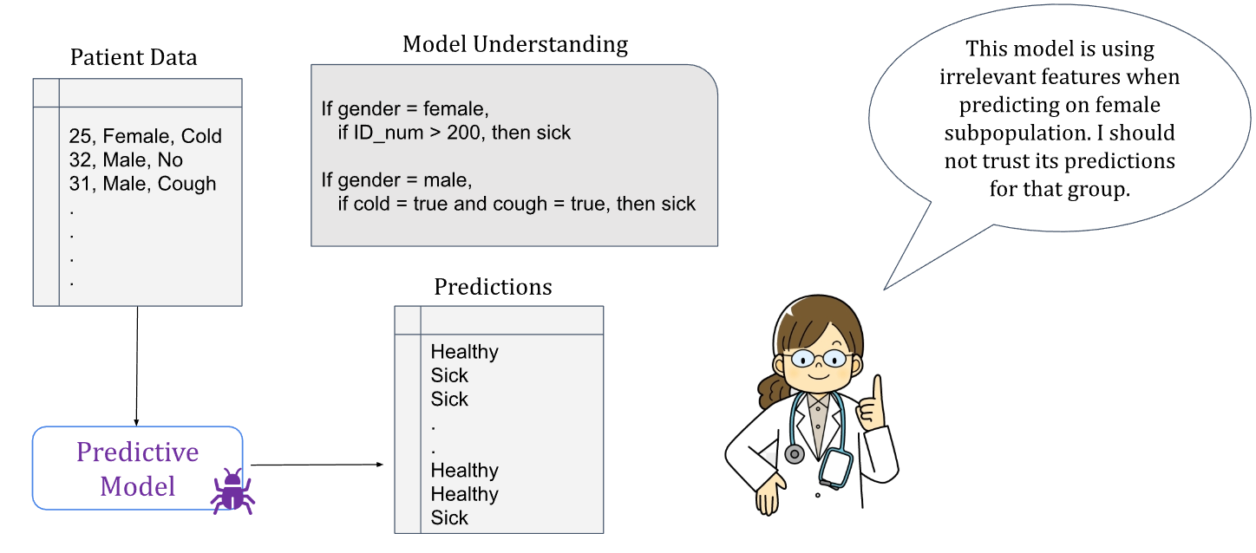
Introduction to XAI
Example 2-Domain expert

Slide 10
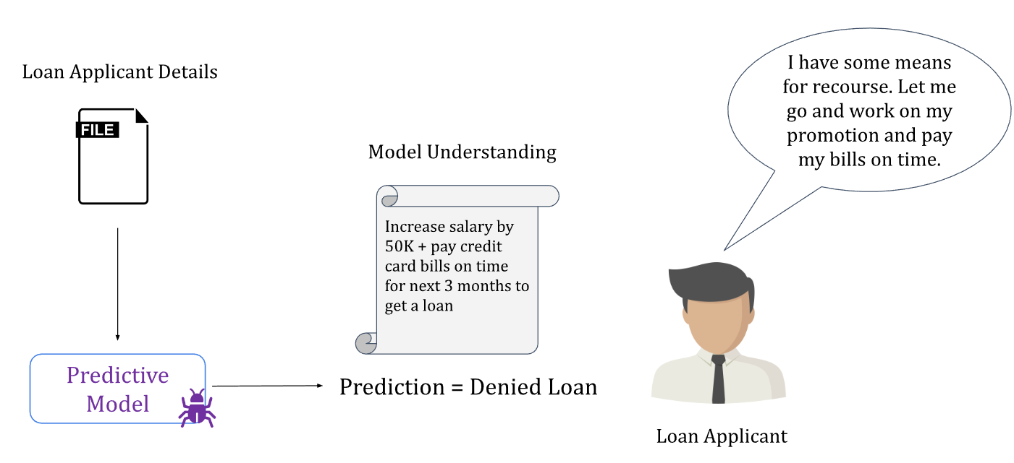
Introduction to XAI
Example 3-Consumers

Slide 11
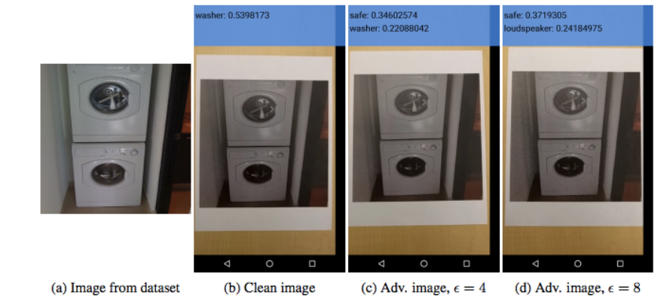
Introduction to XAI
Example 4-Auditors
Notes:
Adversarial attacks, solution: adversarial training

Slide 12
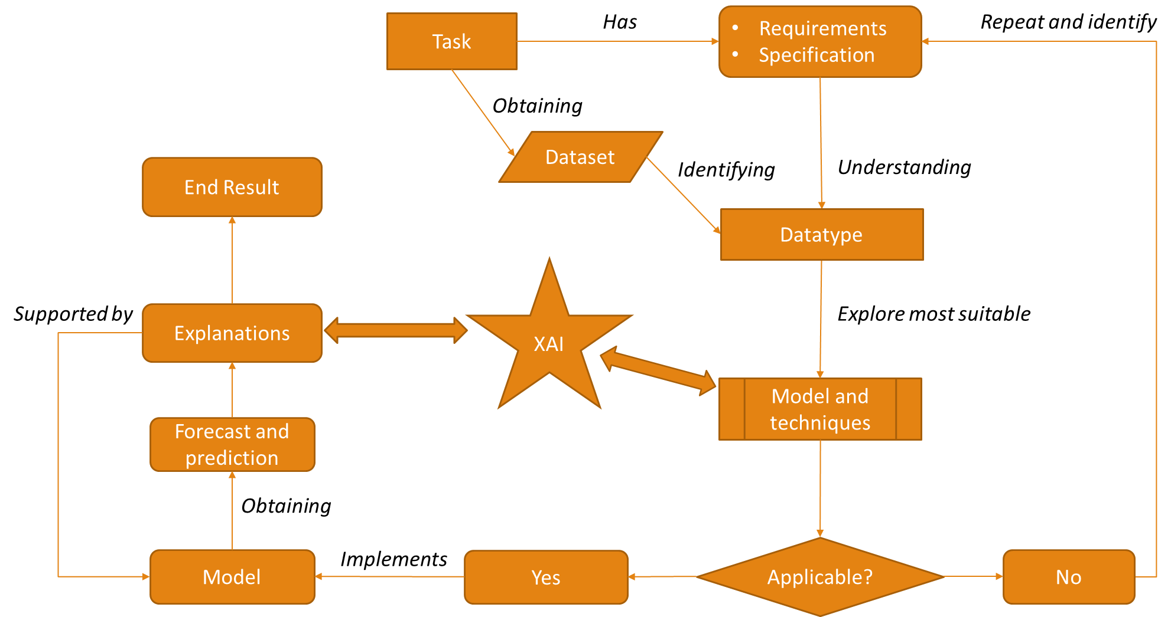
Proposed Framework

Slide 13
Our proposed Problem statement
To explore on XAI and the utilization of various models, methods and techniques to suits various scenario(task)
The Team will be covering the various topic
Tabular Data
CV
NLP
Time series

Slide 14
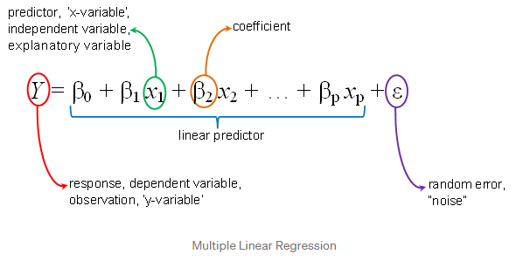
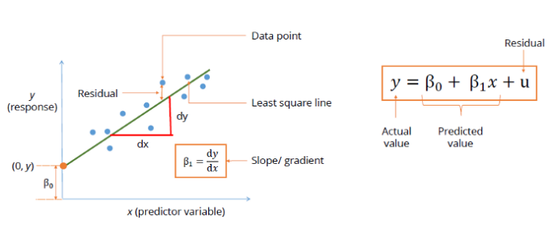
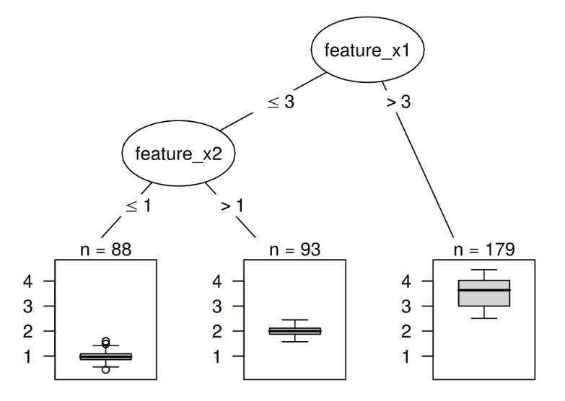
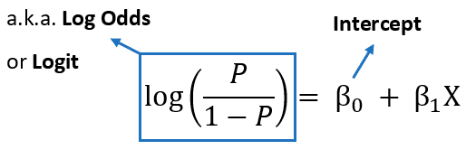
Tabular Data
Inside the Machine Learning algorithms
Interpretable Models:
What are interpretable models?
Linear Regression
Decision Trees
Logistic Regression

Slide 15
Tabular Data
Inside the Machine Learning algorithms
Interpretable Models:
Binary Classification Case Study
Different datasets may be used

Slide 16
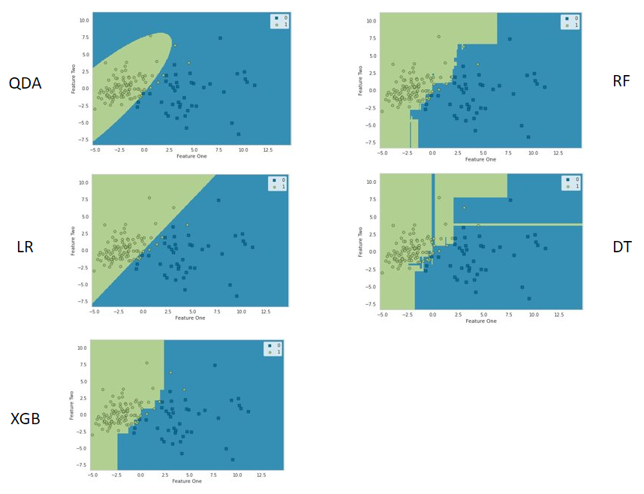
Tabular Data
Inside the Machine Learning algorithms
Interpretable Models:
Due to their relatively ease of accessibility, we can collect useful information directly
Decision Boundary:
How the model separates the classes based on a feature reduction to a 2D space
Useful for?
AI/ML Engineers
Not so much the end-user
Quadratic Discriminant Analysis​
Logistic Regression​
Random Forest​
Decision Tree​
XGBoost

Slide 17
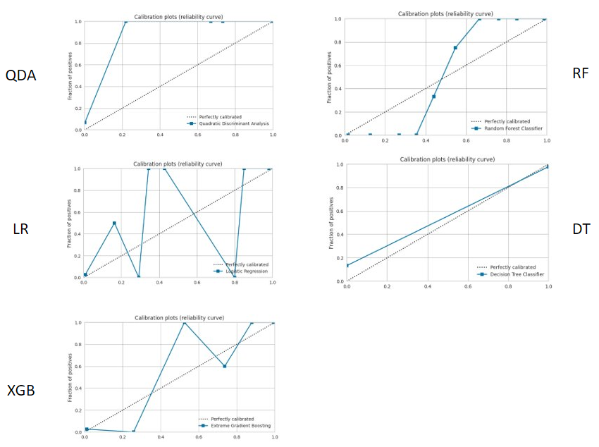
Tabular Data
Inside the Machine Learning algorithms
Interpretable Models:
Due to their relatively ease of accessibility, we can collect useful information directly
Calibration Plot:
Predicting probability of an observation belonging to each possible class.
Predicted probabilities that match the expected distribution of probabilities for each class are referred to as calibrated.
Useful for?
AI/ML Engineers
Quadratic Discriminant Analysis​
Logistic Regression​
Random Forest​
Decision Tree​
XGBoost

Slide 18
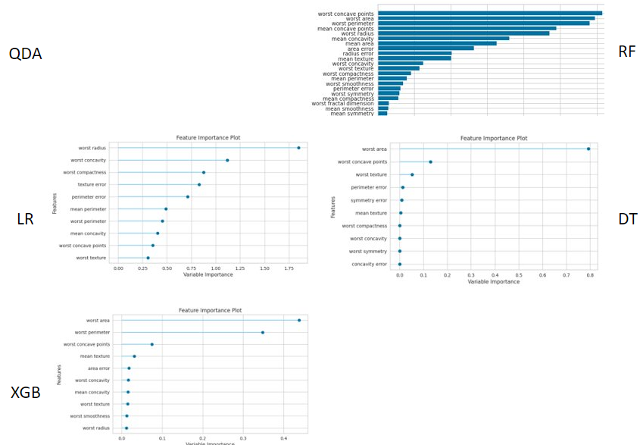
Tabular Data
Inside the Machine Learning algorithms
Interpretable Models:
Due to their relatively ease of accessibility, we can collect useful information directly
Feature Importance Plot:
Identifying features that contributes the highest to the lowest weights for the predicted outcome.
Useful for?
AI/ML Engineers
Quadratic Discriminant Analysis​
Logistic Regression​
Random Forest​
Decision Tree​
XGBoost

Slide 19
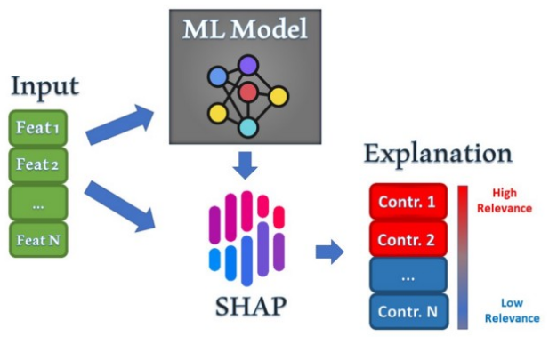
Tabular Data
Some models get complex – Less Interpretable
Global Methods:
With greater model complexity, the ability to draw information directly decreases.
Global agnostic methods of interpretability can be used instead
SHAP (SHapley Additive exPlanations)
Current ML scene without XAI
Prediction outcome
(just take and accept the result)
1. takes the input directly
2. takes output from the model.
3. generate its own weights to the features
4. give a visualization of the explanation

Slide 20
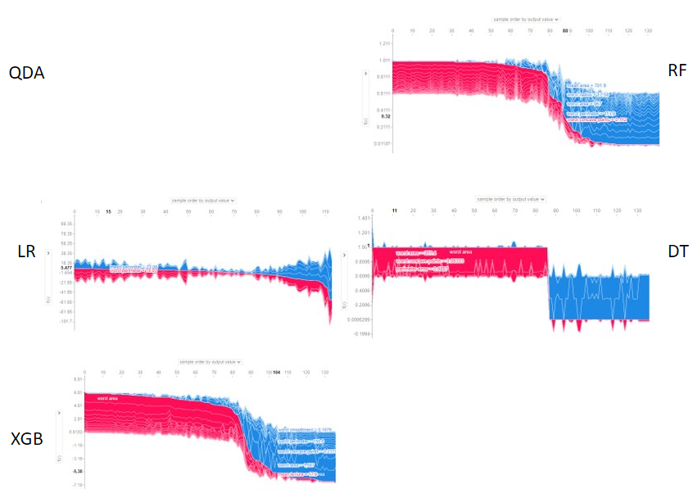
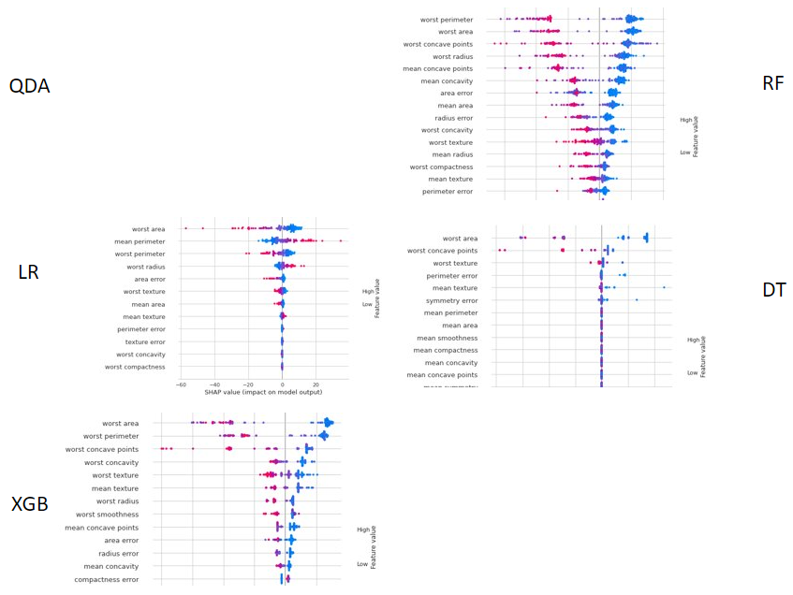
Tabular Data
Some models get complex – Less Interpretable
Global Methods:
With greater model complexity, the ability to draw information directly decreases.
Global agnostic methods of interpretability can be used instead
SHAP (SHapley Additive exPlanations)

Slide 21
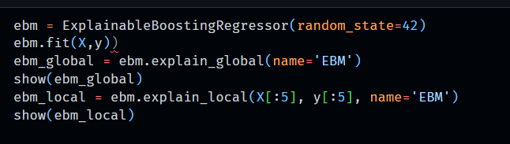
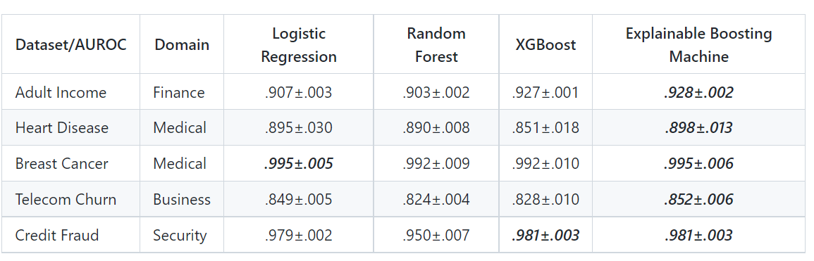
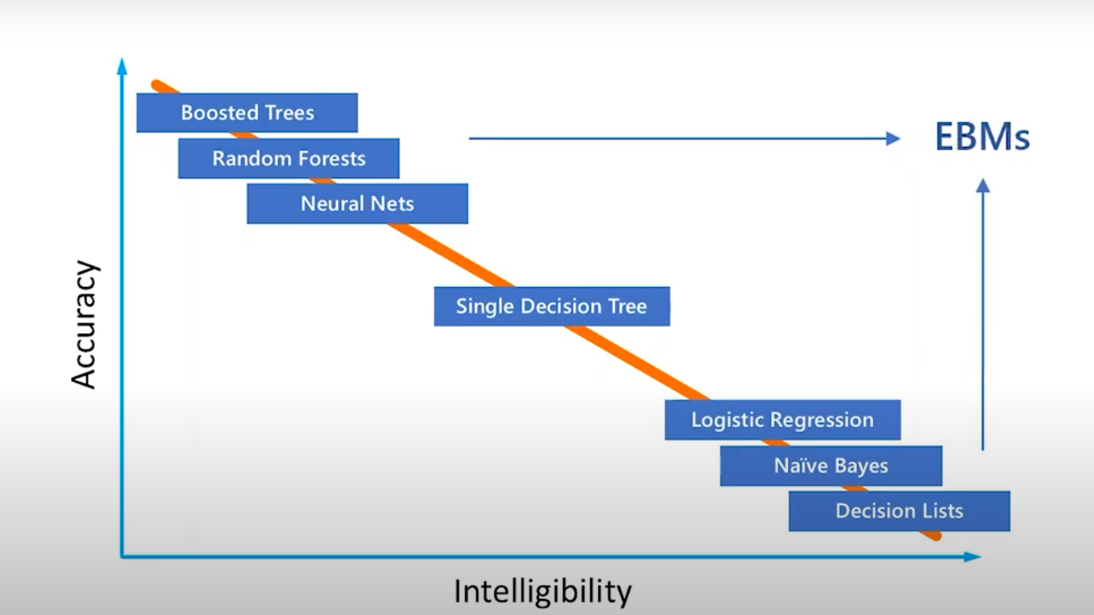
Tabular Data
Explainable Boosting Machine(interpretML)
EDB is tree-based, cyclic gradient boosting Generalized Additive Model developed by Microsoft Research A.I
Performance is onpar with Xgboost and it still maintains high interpretability and its easy to use

Slide 22
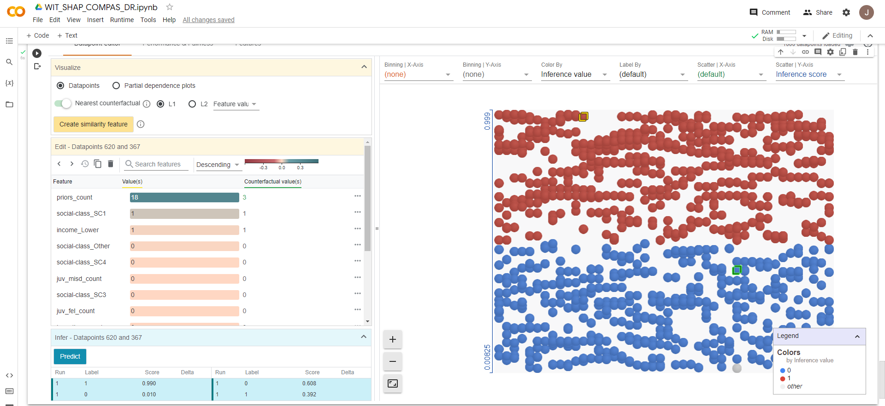
Tabular Data
Google What if Tool (WIT) on Counterfactual Data
Local Methods:
Jupyter Notebook Compatible, measures nearest Distance in the other classification
Good Post-hoc method of spotting potential model bias

Slide 23
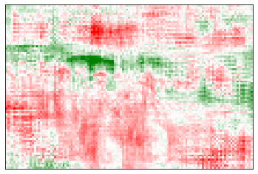
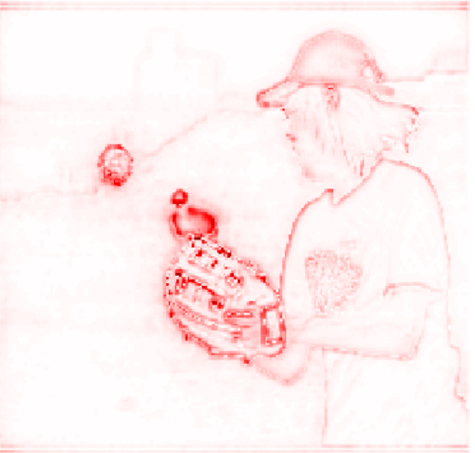
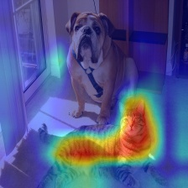
Computer Vision
Interpretability on image data
LRP based or grad-cam based
Popular methods are mostly gradcam and LRP methods
Libraries explored: Captum, LRP toolbox, Grad-cam
Notes:
Integrated gradient based - Calculate gradients to measure the relationship between changes to a feature and changes in the model’s predictions, gradient will tell which pixel has the strongest effect on the model prediction
LRP
Grad-cam based generates a heatmap on which pixel contributed to the feature maps

Slide 24
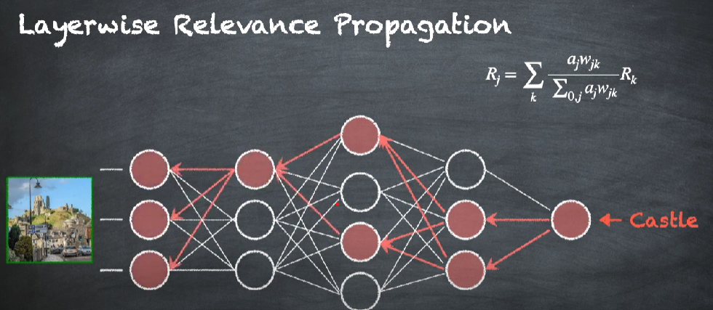

Computer Vision
How does it work?
Notes:
Integrated gradient based - Calculate gradients to measure the relationship between changes to a feature and changes in the model’s predictions, gradient will tell which pixel has the strongest effect on the model prediction
LRP
Grad-cam based generates a heatmap on which pixel contributed to the feature maps

Slide 25
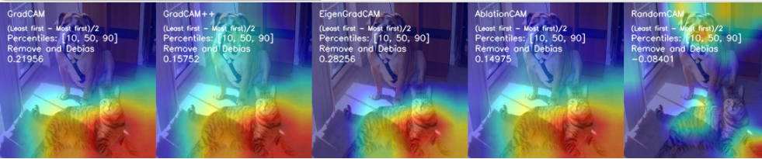
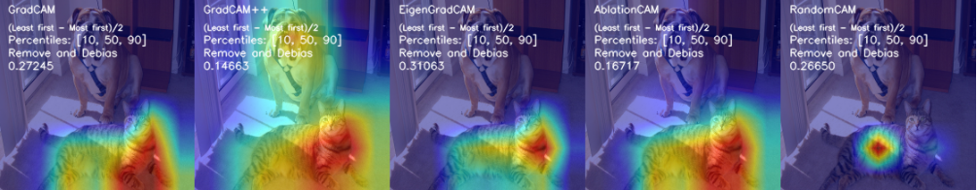
Computer Vision
Grad-Cam
Best visual explanation
Easy to use
Package contains metrics and evaluation for XAI methods(not explored)
Notes:
Metrix and evaluation serve to show
performance of different methods
Help to tune parameters of the model

Slide 26
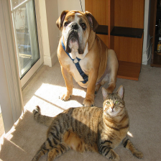
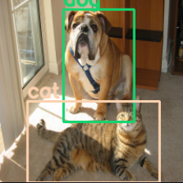
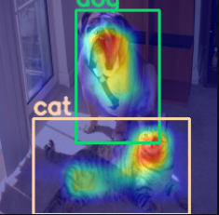
Computer Vision
Example 1-Object detection
Choose neural network
Load image
Create bounding boxes and label
Select XAI method

Slide 27
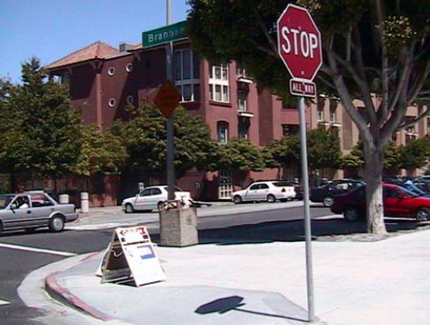
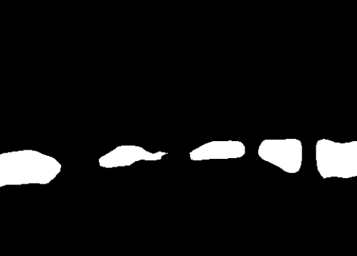
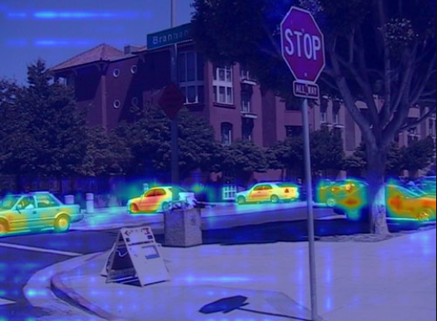
Computer Vision
Example 2-Semantic Segmentation
Choose neural network
Load image
Wrap model and select target class
Select XAI method

Slide 28
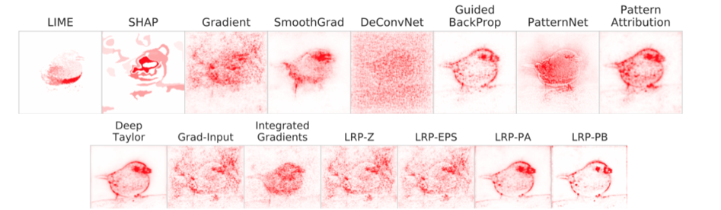


Computer Vision
Which XAI to use?
No clear-cut way to determine
Only solution is to code out each method and compare

Slide 29
Natural Language Processing
Achieving Interpretability on complex models
Binary Classification Case Study
German Offensive Language Dataset

Slide 30
Natural Language Processing
Achieving Interpretability on complex models
τ-ss3 Model:
Innvestigate - Neural Networks:
Concept:
Concept:
τ-ss3 model is used instead of the current deployed model as a surrogate.
τ-ss3 has its own model architecture for natural language processing.
This model comes with in-built interpretation function calls and visualization.
Ability to study the convolution layers to get the interpretation results at what each layer is doing.
Various methods are present to conduct the study. InputXGradient, Integrated Gradients, Layer-wise Propagation, Pattern Attribution, etc.
Present the results manually using visualization tools in python.

Slide 31
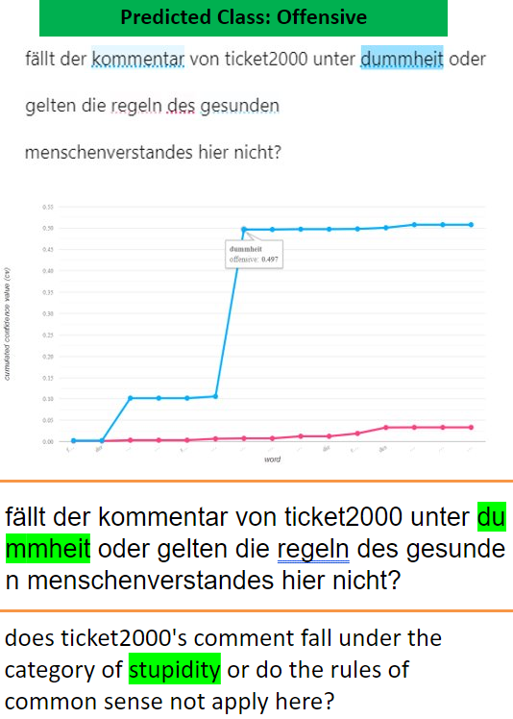
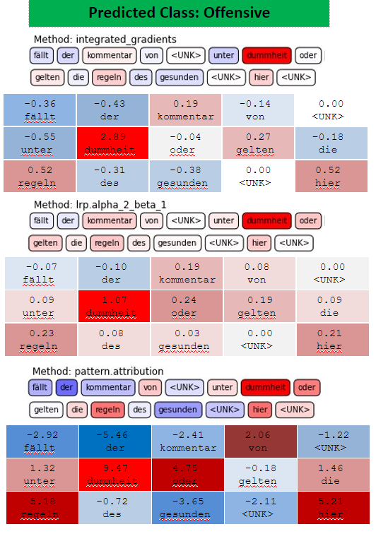
Natural Language Processing
Achieving Interpretability on complex models
τ-ss3 Model:
Innvestigate - Neural Networks:

Slide 32
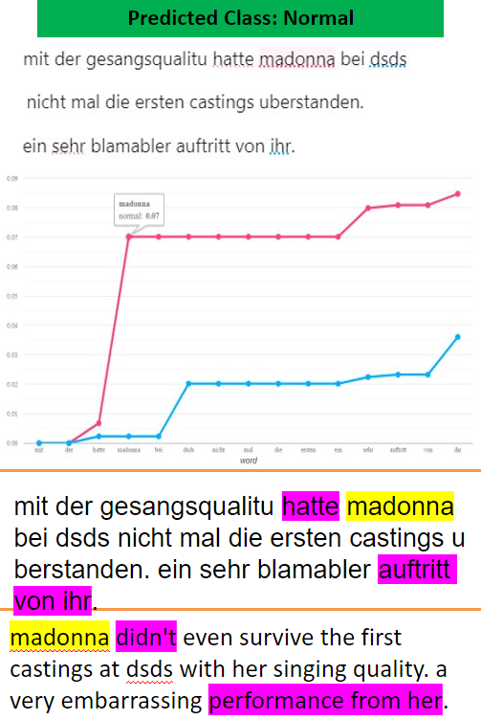
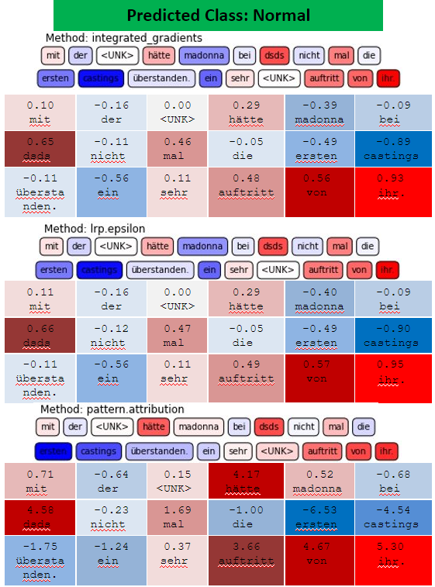
Natural Language Processing
Achieving Interpretability on complex models
τ-ss3 Model:
Innvestigate - Neural Networks:

Slide 33
Natural Language Processing
Achieving Interpretability on complex models
τ-ss3 Model:
Innvestigate - Neural Networks:
Pros:
1. Basically ignores the current model, and if it produces better results, just use this isn't it?
2. In-built preprocessing tools and visualization.
Cons:
1. If τ-ss3 did not do as well as current model. Have to settle for poorer result but with interpretability.
2. Not usable in other NLP tasks like summarization, translation, etc.
Alternatively:
Code similar visualization and interpretation into current model or make a generalized library to achieve same level of visualization.
Pros:
1. Flexibility to choose the method for analysis within innvestigate library given the type of model used, the best method can be used for interpretation (Layer Wise Prop, gradients, pattern attribution etc.)
Cons:
1. Need access to the model build.
2. Library is using tensorflow 1, and requires keras backend.
3. Same flexibility in the pros may become bad if applied wrongly.
Alternative:
Use Captum (pytorch only), more developed and maintained. (Since innvestigate methology is being applied in captum too)

Slide 34
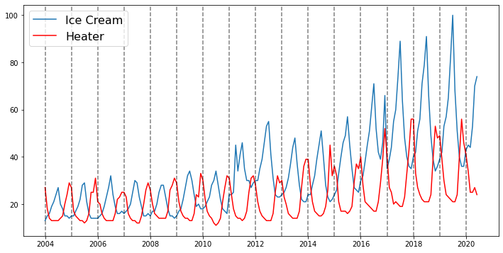
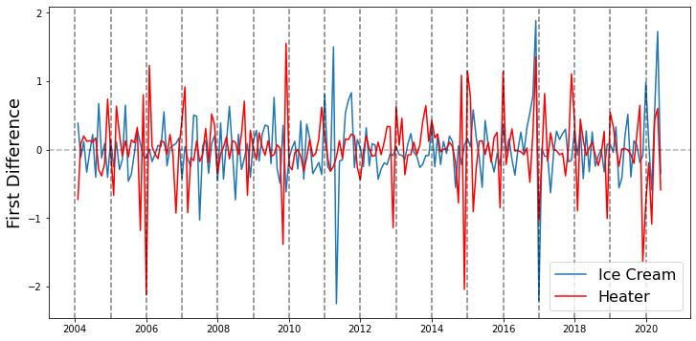
Time Series
XAI/Model for Multivariate Data
Vector Autoregression:
Statistical Model that supports Multivariate Data (2 and more features)
Google Search Trend Data for “Heater” and “Ice Cream” from 2004 to 2011
Pre-processing step needed to make data “stationary”
Non-Stationary Time Series Data
Stationary Time Series Data

Slide 35
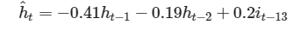
Time Series
XAI/Model for Multivariate Data
Vector Autoregression:
Using p-value threshold of 0.05:
Variable and Lag Value | Coefficient | p-value
Lag 1 Heater | -0.41 | 0.000
Lag 2 Heater | -0.19 | 0.022
Lag 13 Ice Cream | 0.20 | 0.027
Final Equation for Heater Forecast

Slide 36
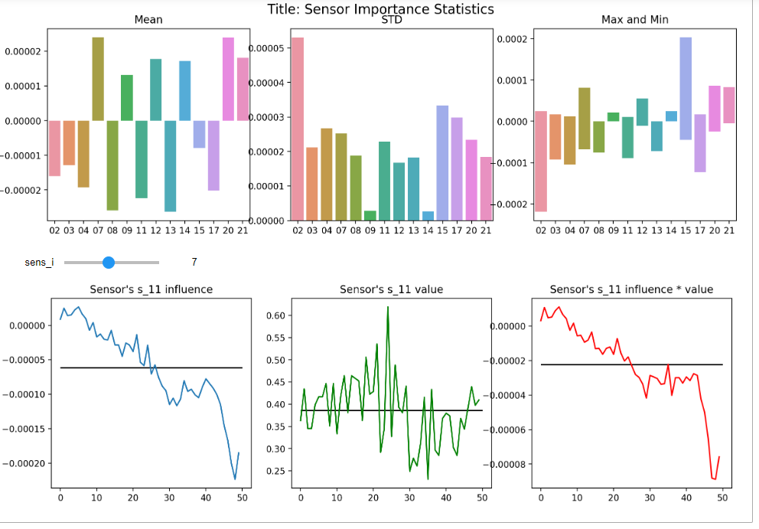
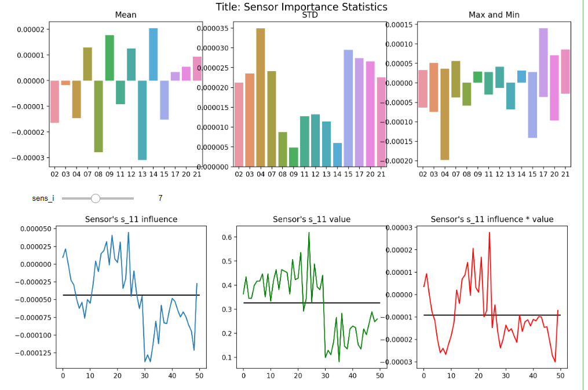
Time Series
XAI/Model for Multivariate Data
LioNets:
Local Surrogate, uses Penultimate Neural Network Layer to create “abstract neighbourhood”.
Requires separate Decoder Training to inverse transform to original values.
Negative influence on RUL
Improved influence on RUL

Slide 37
Time Series
XAI/Model for Multivariate Data
Vector Autoregression:
Pros
Cons
Can fit multivariate data, as compared to other Statistical models (ARIMA)
“Interpretable Model” debatable due to different model assumptions, and/or different metrices used
Useful for? (Potentially) AI Engineer
LioNETS:
Could be used for other data types like NLP
Better than LIME (another XAI method)
Model Specific due to Encoder-Decoder model architecture
Lack of documentation
Need to train a decoder separately, using more resources/time
Useful for?
AI Engineer, Auditors

Slide 38
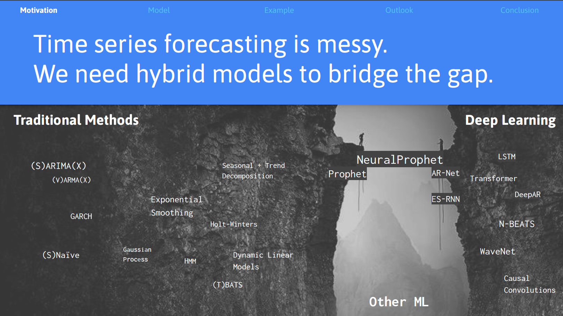
Time Series
Univariate Data
Facebook’s Neural Prophet:
Incorporates both Statistical modelling and Neural Network Architecture
Able to Decompose Time Series and perform Time Series Forecasting

Slide 39
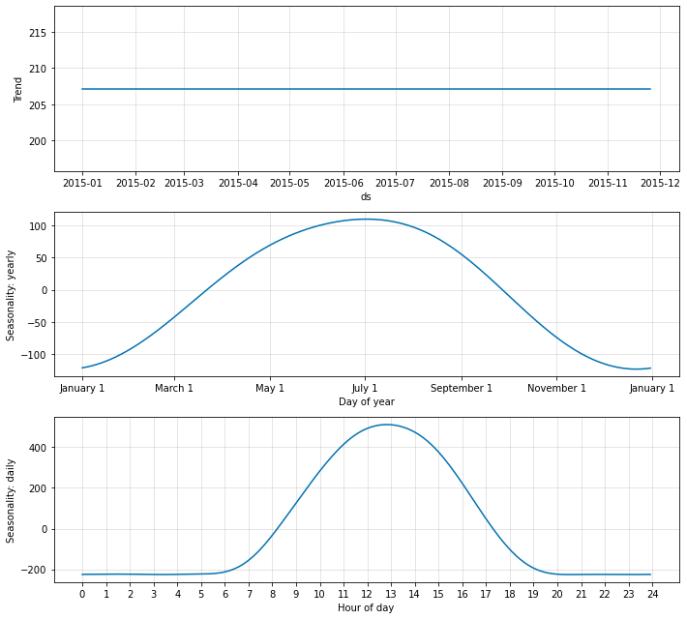
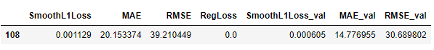
Time Series
Univariate Data
Facebook’s Neural Prophet:
Solar Irradiance Data in San Francisco City, USA
(Baseline Method) Generic Statistical Approach:
Using Neural Network Architecture (1 Step Ahead):
AR Net Hidden Layer Dimension: 8
4 Hidden Layer(s)
Learning Rate: 0.003

Slide 40
Time Series
Univariate Data
Neural Prophet:
Pros
Cons
Combines both Statistical and Neural Network architecture
Good documentation and clear Enhancement Goals
Highly customisable through many hyperparameters both from statistical and neural network
Doesn’t support Multivariate data
Only works for CPU, could be GPU compatible in the future
May not be beginner friendly due to too many hyperparameters
Useful for? AI Engineer, Auditors

Slide 41
Time Series
Closing Remarks
Papers with publicly available code hard to find
XAI Method Under Development
Not releasing code due to “commercialisation” potential
Reluctance to share (proprietary) data
After doing research, doing Time Series using Neural Network Architecture seem novel
XAI on Time Series still has the potential to grow

Slide 42
A.I. Verify
World’s first AI Governance Testing Framework and Toolkit
Toolkit launched by IMDA and PDPC
Currently at MVP and only selected companies can test
 | Tabular | Image | Text | Timeseries | XAI method | Adversarial attack
A.I verify | ✓ | ✓,limited | ✗ | ✗ | Lime,Shap | ✓, AIF360
Nvidia-RP-AI2labs | ✓ | ✓ | ✓ | ✓ | Various | ✗

Slide 43
Conclusion
Making Artificial Intelligence understandable by all is essential to build trust and facilitate widespread adoption. The report explored and evaluated some XAI techniques used for different data type.
While this sub-field is researched mainly in academic circles, the desired outcome is to have XAI available and easily accessible to all users, whether that is an AI Engineer, Auditor or End User.

Slide 44
Acknowledgement
RP academic staffs over the courses of the programme, Nvidia Partner and our project sponsor Yoozoo Games, AI2Labs
Special Thanks to our RP Mentor Mr Seow, Ms Megani
Dr. Goh and his team of engineers Yi Rui, Ding Han, Wai Foong, Tern Poh for the time and assistance.

